Slide 1
Mission Command in Leadership
(insert date)

Slide 2
Objectives
By the end of this lesson, you will be able to:
  Explore approaches for ensuring mission accomplishment while retaining flexibility.
  Describe the principles of mission command.
  Identify approaches to effectively use mission command at the flight level.

Slide 3
Small Group Discussion
In your small groups, consider:
As a leader, how do you get people to do what you want them to do?
(the mission, follow orders, etc.)
Five (5) minutes

Slide 4
Small Group Discussion
Continue your discussion…
As a leader, how do you get people to do what you want them to do
(the mission, follow orders, etc.)
without asking them to do it?
Five (5) minutes

Slide 5
Large Group Discussion
What did you learn?
As a leader, how do you get people to do what you want them to do
(the mission, follow orders, etc.)
without asking them to do it?

Slide 6
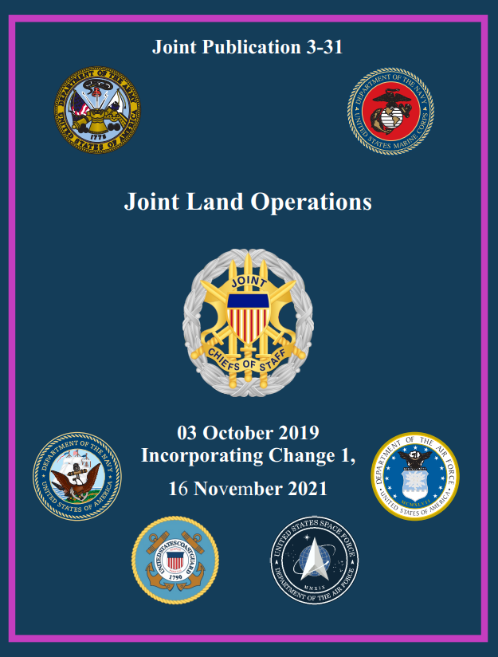
What is Mission Command?
“…the conduct of military operations through decentralized execution based upon mission-type orders.”
AKA
“centralized command, decentralized execution”

Slide 7

Mission Command Defined
“… approach to command and control that empowers subordinate decision making and decentralized execution appropriate to the situation”
“… helps commanders capitalize on subordinate ingenuity, innovation, and decision making to achieve the commander’s intent...”

Slide 8
The Principles of Mission Command
Build cohesive teams through mutual trust
Create shared understanding
Provide a clear commander’s intent
Exercise disciplined initiative
Use mission orders
Accept prudent risks

Slide 9
Applying the Principles of
Mission Command
In your exercise groups…
Lightning Brainstorm Activity
  Review definitions from your worksheet
  Brainstorm methods to implement principles in your flights
  Generate as many ideas as you can in TEN (10) MINUTES
Ready? Go…
Build cohesive teams through mutual trust Create shared understanding | Provide a clear commander’s intent Exercise disciplined initiative | Use mission orders Accept prudent risks

Slide 10
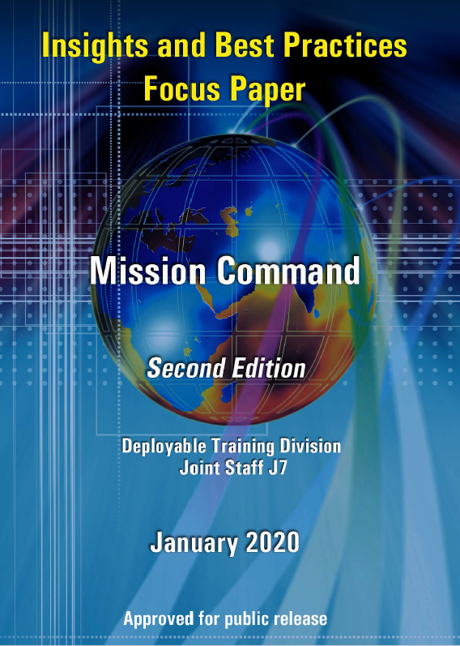
Applying the Principles of
Mission Command
Build cohesive teams through mutual trust
Create shared understanding
Provide a clear commander’s intent
Exercise disciplined initiative
Use mission orders
Accept prudent risks
Groups Outbrief
How will you implement these principles in your flights?
Record ideas you want to try on your worksheet!
The Art of Command

Slide 11
Self-Assessment Exercise
Honestly assess yourself against the listed criteria
  Results are private – sharing is not the intended goal
Contemplate steps for future improvement
You will need these worksheets to finish your Personal Development Plan (PDP) and complete this course.

Slide 12
Break
Come back in 10 minutes!

